Slide 1

GMID 2026 · MPI TORONTO · MAY 6
A 10-MINUTE FIELD GUIDE
You can just talk to it.
A starting point for using AI that doesn't require 25 steps, 17 tools, or a weekend of homework.
Roxanne Kennedy· Boom Business Solutions
boombusinesssolutions.com
Notes:
Most of you know me as Roxanne from Meet in Kamloops. I've been lurking around business events in this industry since 2018 — a lot of us know each other, go to the same events every year. What you might not know is that Meet in Kamloops is actually run by my team at Boom Business Solutions — my comms and PR firm based in Kamloops. I'm telling you that because having a team to do the work that normally falls on one or two people at a destination is what gives me the space to do something I think a lot of us haven't had permission to do yet: actually sit with AI, play with it, break it, and figure out what it can genuinely do for a workday like mine.

Slide 2
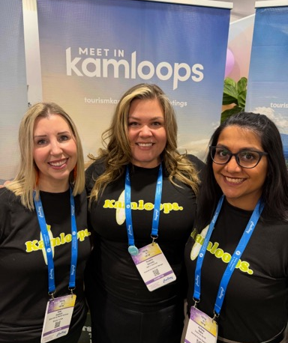
QUICK CONTEXT
Some of you know me as Roxanne from Meet in Kamloops .
What you might not know: Meet in Kamloops is run by my team at Boom Business Solutions my comms + PR firm.
Having a team is what gave me space to actually sit with AI, play with it, and break it.
Notes:
That context matters — because a lot of the AI sessions I've sat through at conferences can make you feel overwhelmed almost immediately. The question I always had was: how does this person talking to me about AI have the time to learn all of this AND do their job in this industry? So before we go anywhere, I want to name what you've probably sat through.

Slide 3
WHAT AI TALKS USUALLY FEEL LIKE
You've sat through these. None of them made you feel capable.
01
Long, convoluted workflows with no entry point.
02
25 rapid-fire steps, thrown at you like a firehose.
03
The slide with seventeen tools on it.
04
The 45-minute product pitch that ends with you somehow responsible for implementation.
If any of that hits home — you're not behind.
Notes:
You know the ones. The long, convoluted workflow with no entry point. The 25 rapid-fire steps thrown at you like a firehose. The slide with seventeen tools on it. The 45-minute product pitch that somehow leaves you responsible for implementation. None of that ever made me feel capable. It made my head spin. So I'd check out — tell myself I'd figure it out later. And later never came. If any of that hits home: you are not behind. You are just waiting for a starting point that actually makes sense for how you work.

Slide 4
THE ONLY TAKEAWAY TODAY
One thing.
That's it. That's the whole talk.
Notes:
So here's the only thing I want you to walk away with today. One thing. That's it.

Slide 5
THE REFRAME
You don't need to use AI perfectly to get value from it.
You just need to talk to it.
Notes:
You don't need to know how to use AI perfectly to get value from it. You just need to know what problem you're trying to solve. Because here's what most people don't realize — you can just talk to it. You can tell it what you're dealing with and ask it to help you figure out what to do next. It asks questions. You answer them. And suddenly you have something useful.

Slide 6
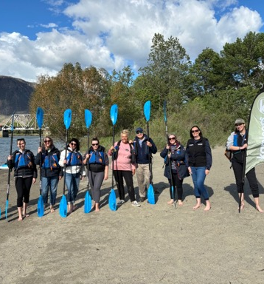
A SCENARIO
Most people in this room have lived this.
You just got back from a fam…
Notes:
Let me make that concrete. Here's a scenario every single person in this room has lived.

Slide 7
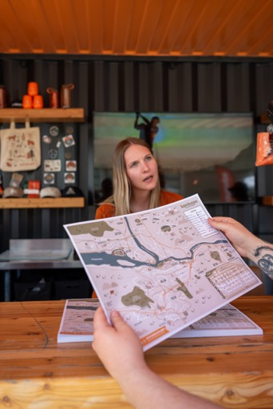
WHAT YOU HAVE TO WORK WITH
Your notes are everywhere.
A voice memo in the van.
Three sentences in your notes app that made sense at the time.
A napkin jammed in the bottom of your bag.
An email you sent yourself at 9pm after a local wine tasting, with three words you were sure would help you write the best report for your client.
OR
You're the supplier with notes in all the same places from conversations with planners, and you need to get it back to them fast.
All you have is sleep you didn't get, you've been out too late three nights in a row, and random notes scattered across your digital and physical work life.
Notes:
You just got back from a fam. You were a planner on someone else's fam, or you were the destination running one. Either way — your notes are everywhere. A voice memo in the van. Three sentences in your notes app that made sense at the time. A napkin jammed in the bottom of your bag. An email you sent yourself at 9pm after a local wine tasting, with three words you were sure would help you write the best report for your client. Or you're the destination, with notes in all the same places from conversations with planners, and you need to get it back to them fast. All you have is sleep you didn't get, you've been out too late three nights in a row, and random notes scattered across your digital and physical work life. (Pause for the knowing laughs.) I've only been on one side of that fam — the destination side. But I've spent enough time with my planner friends, on their fams and after them, to know this hits just as hard from the other side. Ahem — Sam Rosen. You know who you are.

Slide 8
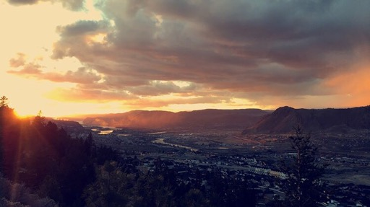
Either way:
All you have is sleep you didn't get
You've been out too late three nights in a row
& random notes scattered across your digital and physical work life.
Notes:
You just got back from a fam. You were a planner on someone else's fam, or you were the destination running one. Either way — your notes are everywhere. A voice memo in the van. Three sentences in your notes app that made sense at the time. A napkin jammed in the bottom of your bag. An email you sent yourself at 9pm after a local wine tasting, with three words you were sure would help you write the best report for your client. Or you're the destination, with notes in all the same places from conversations with planners, and you need to get it back to them fast. All you have is sleep you didn't get, you've been out too late three nights in a row, and random notes scattered across your digital and physical work life. (Pause for the knowing laughs.) I've only been on one side of that fam — the destination side. But I've spent enough time with my planner friends, on their fams and after them, to know this hits just as hard from the other side. Ahem — Sam Rosen. You know who you are.

Slide 9
LET’S MAKE LIFE EASIER
Open it an AI tool. Start talking.
With whatever AI tool you already have access to. They're all capable of this.
Notes:
Here's what I want you to try. With whatever AI tool you already have access to. Doesn't matter which one — they're all capable of this.

Slide 10
STEP ONE
Give it everything you have.
💬
📁
📸
Screenshots of that 9:30pm text
📄
All the destination materials
📝
Photos of napkins
The fam itinerary PDF
The client's RFP
Drag it all into the chat. Don't organize it first. That's the AI's job.
Notes:
Open it up. Start talking. Tell it you just got back from a fam. Then give it everything you have — photos of napkins, screenshots of that 9:30pm text, the fam itinerary PDF, all the destination materials you were handed, the client's RFP if you have it. Attach all of it.

Slide 11
STEP TWO
Then write:
"I need to write a debrief / proposal / report and I have notes / a transcript / scattered info. Ask me clarifying questions until you're 95% confident you can complete the task successfully."
Notes:
When you have a deliverable to create: 'I need to write this, and here's everything I have. Ask me clarifying questions until you're 95% confident you can complete the task successfully.' That one alone will change your output.

Slide 12
TAKE THESE WITH YOU
Starter prompts.
Copy-paste ready. Next 7 slides.
Notes:
So here are the prompts I actually use. The ones that work when you have a project, a problem, or a pile of notes and no idea what to do with any of it. Keep them. Screenshot them. The next few slides are prompts you can copy-paste today.

Slide 13
THE UNIVERSAL STARTER — IF YOU ONLY REMEMBER ONE
SAVE THIS ONE
"Here's what I'm dealing with. I'm not sure what I need yet. Can you help me figure out where to start?"
Prompt 01 of 07
Notes:
And the universal starter — if you only remember one thing on this slide, remember this one. 'Here's what I'm dealing with. I'm not sure what I need yet. Can you help me figure out where to start?' That's the prompt.

Slide 14
WHEN YOU'RE STARTING FROM SCRATCH
"I'm working on X and I don't know where to start. Can you ask me questions to help me figure out the right first step?"
Prompt 02 of 07
Notes:
When you're starting from scratch: 'I'm working on X and I don't know where to start. Can you ask me questions to help me figure out the right first step?' Then — my favourite — 'What am I probably forgetting or underestimating?'

Slide 15
THE BLIND-SPOT CHECK
"What am I probably forgetting or underestimating?"
Prompt 03 of 07
Notes:
When something is not working: 'Here's the situation, here's what I've tried, here's what's not working. What would you try next?' Or: 'Can you ask me questions to help me figure out what the actual problem is?'

Slide 16
This one is brutal in the best way:
What would a top 0.1% person in this field think of this?
Prompt 04 of 07
Notes:
And the universal starter — if you only remember one thing on this slide, remember this one. 'Here's what I'm dealing with. I'm not sure what I need yet. Can you help me figure out where to start?' That's the prompt.

Slide 17
WHEN YOU NEED TO SAY SOMETHING HARD
“Reframe this in a way that challenges how I see the problem”
Prompt 05 of 07
Notes:
When you need to communicate something hard: 'I need to send this email. I want it to sound like me, not a robot. Here's the situation. Here's my draft.' Works every time.

Slide 18
MY FAVOURITE — THE ACCURACY CHECK
“At the end of your answer, give me an accuracy rating, if it's not 100% accurate, list the other possible answers and why you excluded them”
Prompt 06 of 07
Notes:
When something is not working: 'Here's the situation, here's what I've tried, here's what's not working. What would you try next?' Or: 'Can you ask me questions to help me figure out what the actual problem is?'

Slide 19
THE ACCURACY CHECK PART 2
“Cite the source. Give me a list of every fact you relied on”
Prompt 07 of 07
Notes:
When you need to communicate something hard: 'I need to send this email. I want it to sound like me, not a robot. Here's the situation. Here's my draft.' Works every time.

Slide 20
SCREENSHOT THIS SLIDE
The reference card.
UNIVERSAL STARTER
“Here’s what I’m dealing with. I’m not sure what I need yet. Can you help me figure out where to start?”
FROM SCRATCH
“I’m working on X and I don’t know where to start. Can you ask me questions to help me figure out the right first step?”
BLIND-SPOT CHECK
“What am I probably forgetting or underestimating?”
TOP 0.1%
“What would a top 0.1% person in this field think of this?”
REFRAME
“Reframe this in a way that challenges how I see the problem”
ACCURACY CHECK
“At the end of your answer, give me an accuracy rating. If it’s not 100% accurate, list the other possible answers and why you excluded them”
CITE SOURCES
“Cite the source. Give me a list of every fact you relied on”
boombusinesssolutions.com

Slide 21
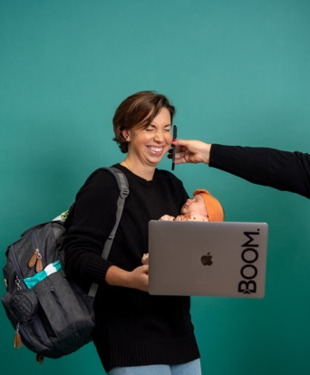
THE CLOSE
The people who'll feel the biggest lift from AI
aren't the ones who took the most courses on it.
They're the ones who got comfortable just talking to it.
Start there. The rest follows.
Notes:
So — that's it. That's the starting point. You don't need a 12-step workflow. You don't need to know the perfect prompt. You just need to open it up and tell it what you're dealing with. The planners and partners and destinations who are going to feel the biggest lift from AI aren't the ones who took the most courses on it. They are the ones who got comfortable just talking to it. Start there. The rest follows.

Slide 22
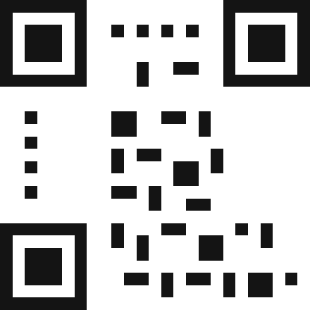
IF YOU WANT HELP GETTING THERE
Program 01
GMID CONFERENCE RATE
AI Foundations & Applied Use
$1,097
A small-group AI training program built for our industry.
Six live sessions, plus an ongoing community of practice.
Per seat · $1,497 regular
AI foundations + the prompts that work for your tasks
DEADLINE · MAY 16, 2026
Role-specific AI assistants for your work
Build your context documents end-to-end
Workflows you'll actually use after the program ends
FORMAT
STARTS
GROUP SIZE
Online · Zoom 6 live sessions, 90 min
Jun 2 – July 7, 2026 Wednesdays 12:00 PM ET
Min 10 · Max 20 so we can go deep
SCAN TO REGISTER
boombusinesssolutions.com/ai
Notes:
And — if you want help getting there — I'm running a small-group AI training program built specifically for our industry. Six live sessions, plus an ongoing community of practice. We cover everything we just talked about, plus building your context documents, role-specific AI assistants, and the workflows you'll actually use. There's a conference rate for anyone who signs up by the end of next week. Scan the QR code or grab me after this session.

Slide 23

GMID 2026 · MPI TORONTO
Thanks.
Now go open it up and tell it what you're dealing with.
Roxanne Kennedy
Boom Business Solutions
boombusinesssolutions.com
Notes:
Thank you.

